Slide 1


Webmarkup
Lecture 2
[3 EC, 84 SBU , Product]
Location : Haarlem
lecture manager : Micha van der Meer
Version 2.11
Notes:
Company logo are respective owned by the companies
Photo’s used are royalty free and under (CC0) license pixels.com
All other not mentioned graphics or text are © Witan BV
Questions ? Lecture material owner Micha van der Meer

Slide 2

Course planning
Term 1 |  | Week
Lecture 1 | Introduction, Webmarkup setup | 36
Lecture 2 | Basic HTML | 37
Lecture 3 | Advanced HTML | 38
Lecture 4 | Basic CSS | 39
Lecture 5 | Advanced CSS | 40
Lecture 6 | Expert CSS + provision and explaining (end)assessment | 41
Lecture 7 | Webmarkup development tools | 43
Exam weeks | Finishing assessment | 44
 | Deadline assessment | 45
2

Slide 3

Questions about previous lectures?
Eur 32.400 (HOMEWORK??)
Webmarkup is logic
Notepad ++
Web browsers
Github
SAAS, PAAS & NAS
Filezilla
Resources on internet
Homework (student.txt, Sourcetree, LinkedIn, autoformat code notepad++, Chapter 1,2 & 21 etc...)
3
Notes:
Who did his homework?? Hmmm I did not get that many request from students at linkedin !
I’m not disappointed. I'm afraid of the consequences of your grade for Webmarkup. (after year 4)
DO not ask questions about SEO during your end assessment!!

Slide 4




Right and wrong
4
Notes:
All roads leads to Rome. But our examples in this lecture are more like right or wrong.
(CC0) license

Slide 5

Quiz
5 min
HTML 5 or not? | Right | Wrong
I. <!DOGTYPE HTML5>
II. <html lang=“ko”>
III. <ul><li><ul><li>
IV. <a url="http://www.taekwon.nl">link</a>
V. WebMail.UserName = "micha@mma-games.com";
VI. <h6>Inholland</h6>
VII. <title name=“This website is great" />
5
Notes:
NO, Typos and CAPS! there are no dogs in HTML and html is in lower case and it is not <!DOGTYPE html5> (the tag ) but the only good solution is <!DOCTYPE html>
Yes, double quote is “auto correct” by powerpoint while using copy paste if you have a Dutch keyboard. In this case the language of the page is in Korean
MAYBE … NO, Missing some closing tags . YES, just apart from the code;.. an unordered (bulleted) list in a list item
NO, url is not the same like href -> url is referring to the place on the hard disk on the webserver. Href is referring to make a jump to another place like a content page on a book.
NO, ASP.NET Web Pages - WebMail Object
Yes, no problem.
NO, title can be used in the head. Like, <tilte>my title </title> OR for search engines and hyperlinks <element title=“text”>for google like,… <p title=“inholland">Learn webmarkup!</p>.

Slide 6

Why learning HTML5?
6
Notes:
15 % still using Flash.
88% of the sites are using JavaScript.
0.1 % Java.
Flash will also be retired from these browsers by early 2021 at the latest, leaving users with nowhere official to go if they want to access Flash-based sites or content.
But you like to develop something in 3D. There are solutions in the next slides

Slide 7



Why learning HTML5 [History of Flash]
!=
2007
7
Notes:
Who is this?
When was the introduction from the iPhone
Steve Jobs introduced the iPhone 1 in 2007!
© Photo Steve Jobs at the 2010 Worldwide Developers Conference by Matt Yohe. matt.yohe@gmail .com.

Slide 8


Why learning HTML5 [native app development]
8
Notes:
APP development is out of scope
Unity3D -> Games 3rd year game development
Do not worry about APPS, out of scope!

Slide 9

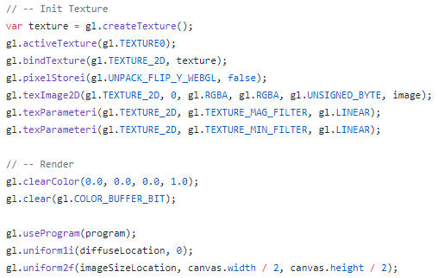
Why learning HTML5 [3D development]
9
Notes:
OUT OF SCOPE!
WebGL is an open standard for 3D development and have a good connection with HTML5
https://www.chromeexperiments.com/experiment/fluid-particles
Do not worry about WEBGL, out of scope!

Slide 10


Why learning HTML5 [convert website to app]
10
Notes:
CORDOVA IS OUT OF SCOPE! But have a good connection with HTML5
2nd and 3rd Year
https://www.appypie.com/convert-website-to-mobile-apps
https://cordova.apache.org/docs/en/latest/guide/cli/

Slide 11


HTML vs CSS [Resume lecture 1]
[HTML]
HTML (HyperText Markup Language) is the language in which you structurize the webpage
HTML divides documents in parts/sections
[CSS]
Colours
Margins
Positioning
Style
11
Notes:
This is our scope!
(CC0) license

Slide 12

HTML 5 – What is new
Audio & Video [multimedia support]
Input element types [type = email]
Field and range validators [min=“6” max=“16”]
Canvas [painting]
Custom data attributes [JS & JQuery]
Editable content [User interaction]
Media Queries [max-width: 640px]
API [Application Programming Interfaces]
Geolocation [Position]
12
Notes:
<video src="Video file path" controls>
<input id="EmailIdInput" type="email" />
<input type="number" name="NumberOfItems" min="10" max="50" required/>
<canvas id="myCanvas" width="200" height="100">
<span class="user" data-domain="Technology" data-language="C#">
<p contenteditable="true">Click here to edit this content!</p>
[max-width: 640px]
Like : Drag drop , Local storage, Web workers, SSE (Server-Sent Events)
https://www.w3schools.com/html/html5_geolocation.asp

Slide 13

DOCTYPES in HTML
13
Notes:
(CC0) license
Any questions about terms. Please let us know. If we talk about doc types and all you can think is a dog…

Slide 14
DOCTYPES in HTML
<!DOCTYPE HTML> <html> <body> <video width=“640" height="480" controls> <source src=“diablo3.mp4" type="video/mp4"> <source src=“diablo3.ogg" type="video/ogg"> Your browser do not support loot goblins. </video> </body>
</html> </html>
XHTML 1.0 Strict
XHTML 1.0 Transitional
…..
HTML 4.0.1 Strict
HTML 5
14
Notes:
<!DOCTYPE HTML> -> No, it is html in lowercase!
XHTML (Extensible Hypertext Markup Language)
Strict (error and does not validate) -> does NOT INCLUDE presentational or deprecated elements
Elements that are not allowed in Strict DOCTYPEs
center
font
iframe
strike
u
Attributes not allowed in Strict DOCTYPEs
align (allowed on elements related to tables: col, colgroup, tbody, td, tfoot, th, thead, and tr)
language
background
bgcolor
border (allowed on table)
height (allowed on img and object)
hspace
name (allowed in HTML 4.01 Strict, not allowed on form and img in XHTML 1.0 Strict)
noshade
nowrap
target
text, link, vlink, and alink
vspace
width (allowed on img, object, table, col, and colgroup)

Slide 15

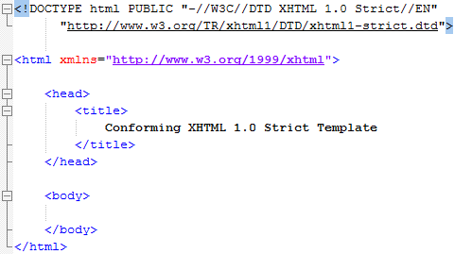
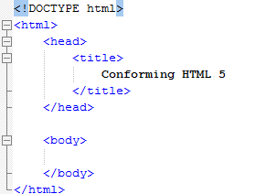
HTML – Compare versions
HTML Strict 1.0
HTML5
15
Notes:
Why defined a doctype with settings???
Screens at that time where only 80 chars!

Slide 16

HTML – Compare versions
HTML Strict 1.0
HTML5
16
Notes:
Why we do not have 80 chars per row?
We never know what device our webpage will visit.
SEO , TV, Mobile
Imagine if we must download all definitions for all possible devices (latency)
https://hsivonen.fi/doctype/

Slide 17
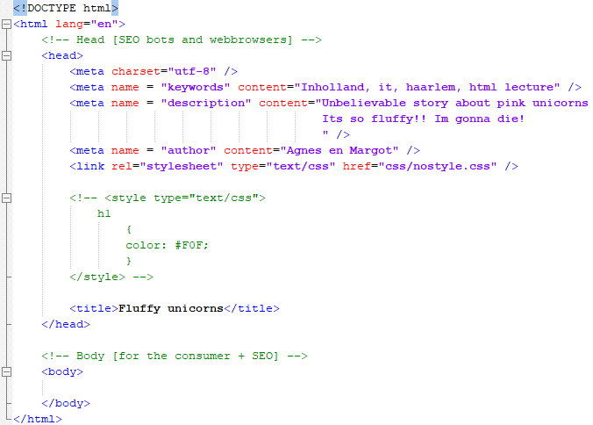

HTML – Structure <body>
17
Notes:
HTML is about structure. Everything with colors, sizes and positions etc.. Is forbidden.
<head></head>

Slide 18
HTML – Structure
USE TABS
18
Notes:
USE TABS!

Slide 19
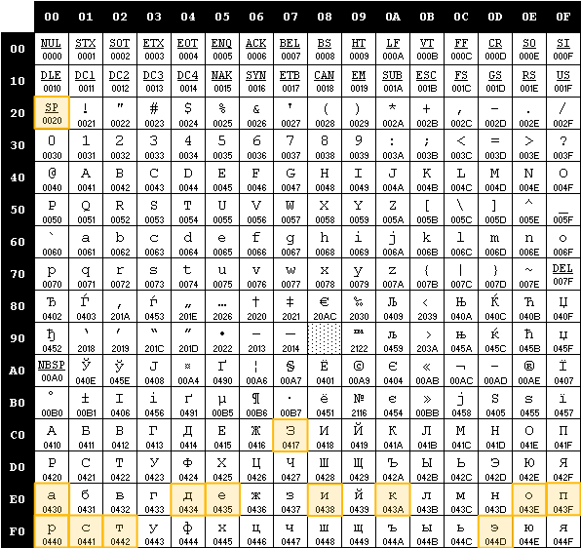
HTML – <meta charset="utf-8">
19
Notes:
Why are we or can we using UTF 8 (256 chars)?
We are using the Greek alphabet with only -> 26 letters !

Slide 20
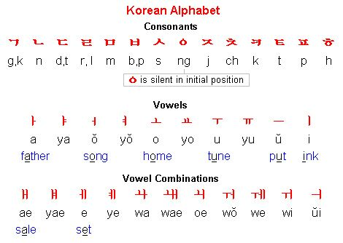

HTML – <meta charset="utf-8“ /> ?
20
Notes:
Hangul have 14 consonants and 10 vowels (in theory 24 letters) so this could fit in 255 spaces from UTF 8.

Slide 21
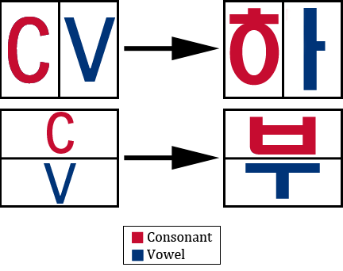
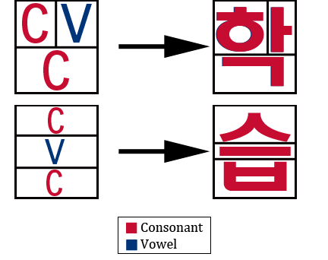
HTML – <meta charset="utf-8“ /> ?
21
Notes:
Ha Nice try….but Korean

Slide 22
HTML – <meta charset="utf-8“ /> ?
 | 0x00 | 0x01 | 0x02 | 0x03 | 0x04 | 0x05 | 0x06 | 0x07 | 0x08 | 0x09 | 0x0A | 0x0B | 0x0C | 0x0D | 0x0E | 0x0F
0xac00 | 가 | 각 | 갂 | 갃 | 간 | 갅 | 갆 | 갇 | 갈 | 갉 | 갊 | 갋 | 갌 | 갍 | 갎 | 갏
0xac10 | 감 | 갑 | 값 | 갓 | 갔 | 강 | 갖 | 갗 | 갘 | 같 | 갚 | 갛 | 개 | 객 | 갞 | 갟
0xac20 | 갠 | 갡 | 갢 | 갣 | 갤 | 갥 | 갦 | 갧 | 갨 | 갩 | 갪 | 갫 | 갬 | 갭 | 갮 | 갯
0xac30 | 갰 | 갱 | 갲 | 갳 | 갴 | 갵 | 갶 | 갷 | 갸 | 갹 | 갺 | 갻 | 갼 | 갽 | 갾 | 갿
0xac40 | 걀 | 걁 | 걂 | 걃 | 걄 | 걅 | 걆 | 걇 | 걈 | 걉 | 걊 | 걋 | 걌 | 걍 | 걎 | 걏
0xac50 | 걐 | 걑 | 걒 | 걓 | 걔 | 걕 | 걖 | 걗 | 걘 | 걙 | 걚 | 걛 | 걜 | 걝 | 걞 | 걟
0xac60 | 걠 | 걡 | 걢 | 걣 | 걤 | 걥 | 걦 | 걧 | 걨 | 걩 | 걪 | 걫 | 걬 | 걭 | 걮 | 걯
0xac70 | 거 | 걱 | 걲 | 걳 | 건 | 걵 | 걶 | 걷 | 걸 | 걹 | 걺 | 걻 | 걼 | 걽 | 걾 | 걿
0xac80 | 검 | 겁 | 겂 | 것 | 겄 | 겅 | 겆 | 겇 | 겈 | 겉 | 겊 | 겋 | 게 | 겍 | 겎 | 겏
0xac90 | 겐 | 겑 | 겒 | 겓 | 겔 | 겕 | 겖 | 겗 | 겘 | 겙 | 겚 | 겛 | 겜 | 겝 | 겞 | 겟
0xaca0 | 겠 | 겡 | 겢 | 겣 | 겤 | 겥 | 겦 | 겧 | 겨 | 격 | 겪 | 겫 | 견 | 겭 | 겮 | 겯
0xacb0 | 결 | 겱 | 겲 | 겳 | 겴 | 겵 | 겶 | 겷 | 겸 | 겹 | 겺 | 겻 | 겼 | 경 | 겾 | 겿
0xacc0 | 곀 | 곁 | 곂 | 곃 | 계 | 곅 | 곆 | 곇 | 곈 | 곉 | 곊 | 곋 | 곌 | 곍 | 곎 | 곏
0xacd0 | 곐 | 곑 | 곒 | 곓 | 곔 | 곕 | 곖 | 곗 | 곘 | 곙 | 곚 | 곛 | 곜 | 곝 | 곞 | 곟
0xace0 | 고 | 곡 | 곢 | 곣 | 곤 | 곥 | 곦 | 곧 | 골 | 곩 | 곪 | 곫 | 곬 | 곭 | 곮 | 곯
0xacf0 | 곰 | 곱 | 곲 | 곳 | 곴 | 공 | 곶 | 곷 | 곸 | 곹 | 곺 | 곻 | 과 | 곽 | 곾 | 곿
0xad00 | 관 | 괁 | 괂 | 괃 | 괄 | 괅 | 괆 | 괇 | 괈 | 괉 | 괊 | 괋 | 괌 | 괍 | 괎 | 괏
0xad10 | 괐 | 광 | 괒 | 괓 | 괔 | 괕 | 괖 | 괗 | 괘 | 괙 | 괚 | 괛 | 괜 | 괝 | 괞 | 괟
0xad20 | 괠 | 괡 | 괢 | 괣 | 괤 | 괥 | 괦 | 괧 | 괨 | 괩 | 괪 | 괫 | 괬 | 괭 | 괮 | 괯
0xad30 | 괰 | 괱 | 괲 | 괳 | 괴 | 괵 | 괶 | 괷 | 괸 | 괹 | 괺 | 괻 | 괼 | 괽 | 괾 | 괿
22
Notes:
All can be combined with each other - giving a total of 11,172 different hangul.
http://www.fileformat.info/info/unicode/block/hangul_syllables/utf8test.htm

Slide 23
HTML – Structure, value
<title>Fluffy unicorn</title> Element
<meta /> , <title>,</title> Tags [single and paired]
charset, name, etc Attribute
utf-8, keywords, etc Value
23

Slide 24
HTML – Element & tags
ELEMENT
<title> Unicorns </title>
“OPENING”-TAG
TEXT
“CLOSING”-TAG
24

Slide 25

HTML – Attributes
ELEMENT
<meta charset="utf-8" />
TAG
ATTRIBUTE
TAG
ATTRIBUTE NAME
ATTRIBUTE VALUE
Attributes are case sensitive! CharSet = “utf-8”
25
Notes:
UTF8

Slide 26
HTML – Localization
ELEMENT
<html lang="en" />
TAG
ATTRIBUTE
TAG
ATTRIBUTE NAME
ATTRIBUTE VALUE
lang = “en” is not mandatory but can come in handy. (when using a screenreader for example)
26
Notes:
UTF8

Slide 27

Assignment lecture 2.1
Create a webpage “index_assignment_2_1.html”
Add a title
Add meta information.
charset
name keywords for a website about you
description for a website about you
author
Test your website on Chrome, Edge and Firefox
Commit work on GitHub
FTP your work on your webserver
20 min
27
Notes:
Royalty free (CC0) license
Teacher guide : Min 30 – 40 (from 135 min)
TEST -> You will see your website title in the browser!

Slide 28
HTML – Body of the Webpage
28
Notes:
<body></body>

Slide 29
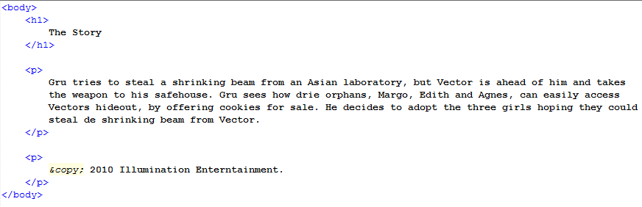
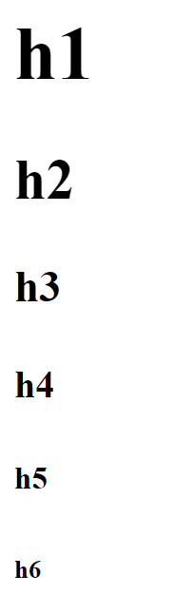
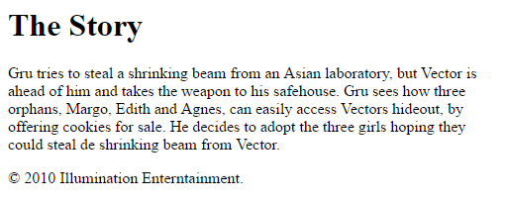
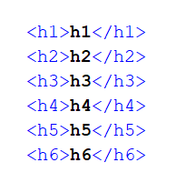
HTML – Entities
Result | Description | Entity Name | Entity Number
 | non-breaking space | &nbsp; | &#160;
< | less than | &lt; | &#60;
> | greater than | &gt; | &#62;
& | ampersand | &amp; | &#38;
" | double quotation mark | &quot; | &#34;
' | single quotation mark (apostrophe) | &apos; | &#39;
¢ | cent | &cent; | &#162;
£ | pound | &pound; | &#163;
¥ | yen | &yen; | &#165;
€ | euro | &euro; | &#8364;
© | copyright | &copy; | &#169;
® | registered trademark | &reg; | &#174;
<h1> </h1> tag
<p> </p> tag
align="right“ [HTML 4.01] attribute & value
29
Notes:
Entities,
<p> should be a footer,.. But this later :P

Slide 30
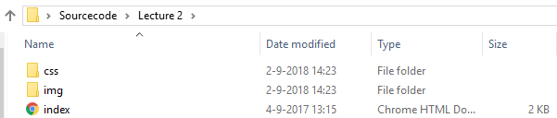

HTML – Images in the /img folder
30
Notes:
Despicable me ©2010 Illumination Entertainment

Slide 31
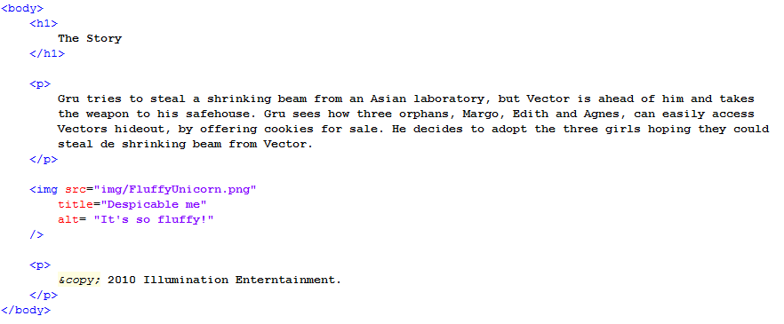
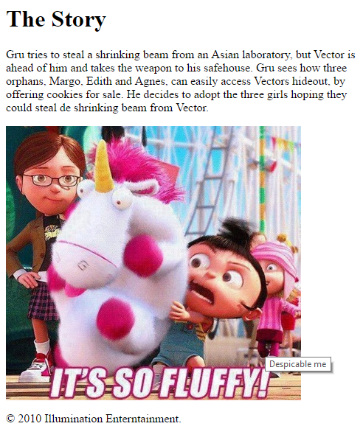
HTML – Images
<img /> tag
src = “url/folder/filename.ext” attribute, value
titel = “linkin park - recharge” attribute, value
alt = “improve the world” attribute, value
width =“100px“ [HTML 4.01] attribute & value
heigth =“100px“ [HTML 4.01] attribute & value
31
Notes:
DO NOT ADD STYLE IN HTML!
It is possible but 50 shades of grey :P

Slide 32
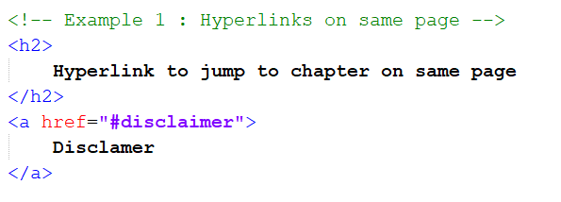
HTML – <!-- comment HTML sourcecode -->
32

Slide 33

HTML – Hyperlink [1/4]
33

Slide 34
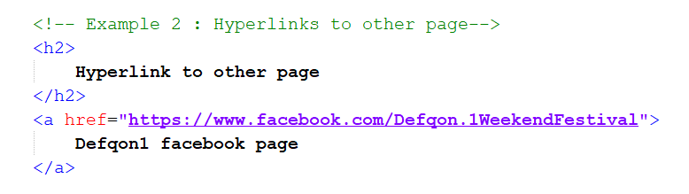
HTML – Hyperlink [2/4]
34

Slide 35
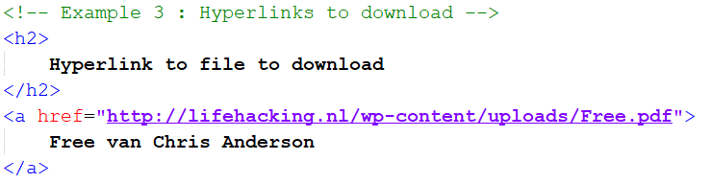
HTML – Hyperlink [3/4]
35

Slide 36
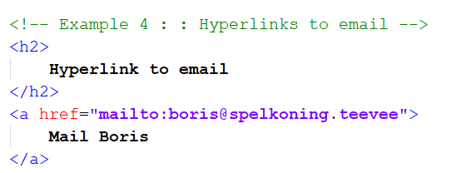

HTML – Hyperlink [4/4]
36
Notes:
Use only for testing.. Normally use form and php / asp backend.

Slide 37
Assignment lecture 2.2
Copy webpage “index_ assignment_2_1.html” to “index_ assignment_2_2.html”.
Add heading 1 and heading 2.
Add a paragraph with a small story about yourself.
Add your hyperlink to your own LinkedIn page.
Add a small paragraph where you visit London, New York and Paris and where you bought souvenirs with $, € and £. Use entities for the currencies.
Find a picture on internet that has a resolution of 300px by 300px and add this to your webpage. (https://placeimg.com/)
Test your website on Chrome, Edge and Firefox.
Summit work on GitHub.
FTP your work on your webserver.
20 min
37
Notes:
Royalty free (CC0) license
Teacher guide : Min 60 – 70 (from 135 min)
TEST -> You will see your website title in the browser!

Slide 38
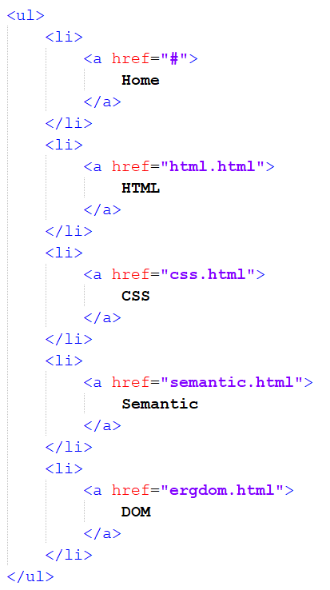
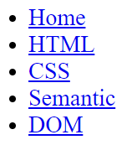
HTML – Unordered list
38

Slide 39
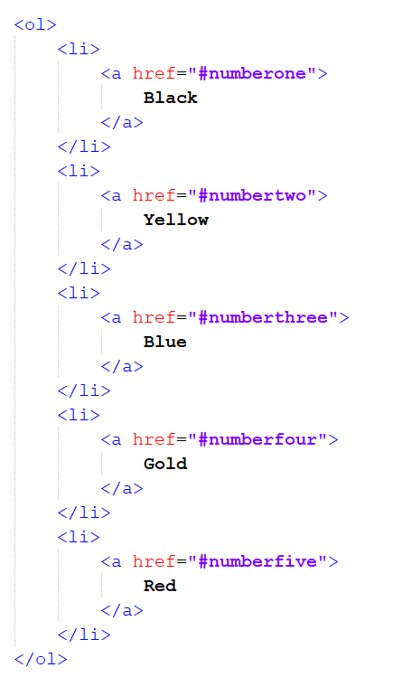
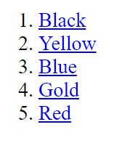
HTML – Ordered list
39

Slide 40
HTML – Table
<table> = table
<tr> = table row
<th> = table head
<td> = table data
40

Slide 41
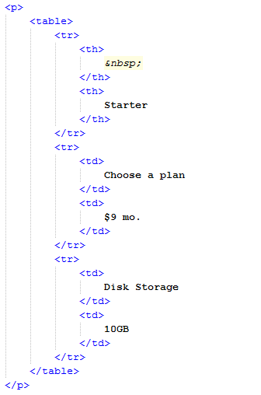

HTML – Table
41

Slide 42
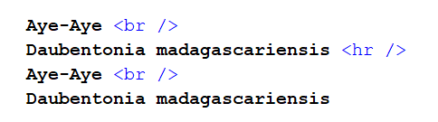
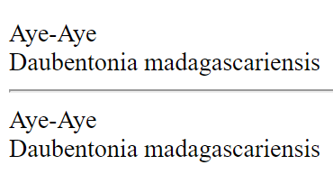
HTML – Forbidden elements (PART 1)
42
Notes:
All design :P
USE BLOCK ELEMENTS (next slide) OR CSS!

Slide 43
HTML – Block and Inline elements
Block-level elements
<address> <article> <aside> <blockquote> <canvas> <dd> <div> <dl> <dt> <fieldset> <figcaption> <figure> <footer> <form> <h1>-<h6> <header> <hr> <li> <main> <nav> <noscript> <ol> <output> <p> <pre> <section> <table> <tfoot> <ul> <video>
Inline elements
<a> <abbr> <acronym> <b> <bdo> <big> <br> <button> <cite> <code> <dfn> <em> <i> <img> <input> <kbd> <label> <map> <object> <q> <samp> <script> <select> <small> <span> <strong> <sub> <sup> <textarea> <time> <tt> <var>
43
Notes:
https://html.spec.whatwg.org/multipage/text-level-semantics.html#the-br-element
https://html.spec.whatwg.org/multipage/grouping-content.html#the-hr-element
The HR element is defined to be element of block. It’s also being displayed in its own line like any other block element. Thus HR is a block element.
The BR element is defined to be element of special and that is defined to be inline. It’s also not being displayed in its own like like a block element, but just creating a line break. Thus BR is an inline element.

Slide 44
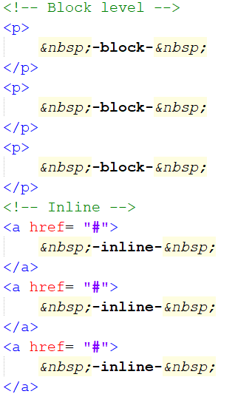
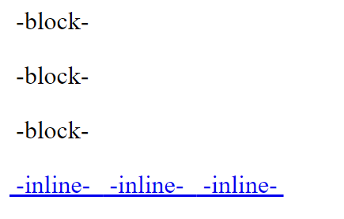
HTML – Block and Inline elements
44
Notes:
All design :P

Slide 45
Assignment lecture 2.3
Copy webpage “index_ assignment_2_2.html” to “index_ assignment_2_3.html”.
Add an ordered list from your top 5 snacks you love to eat.
Add an unordered “bucket list” with 5 things you like to do before you die.
Add table with the courses you follow in the next weeks. In the table header; course name, EC’s, expected time on homework, expected grade.
Add 3 inline elements and 3 block elements on the page.
Test your website on Chrome, Edge and Firefox.
Summit work on GitHub.
FTP your work on your webserver.
20 min
45
Notes:
Royalty free (CC0) license
Teacher guide : Min 90 – 100 (from 135 min)
TEST -> You will see your website title in the browser!
[feb 19]Suzanne, thanks for the correction in the Assignment

Slide 46

Resume lecture
What is HTML5
Doctypes
Flash, WebGL, Cordova and Unity3D
HTML structure [Tabs]
UTF-8
Meta info
Single and paired tags
Elements and attributes
Head & Body
Head 1 – 6 <h1>
Paragraphs <p>
Entities &nbsp;
Images <img />
Hyperlinks <a>
Lists <ul><ol>
Tables <table>
Block and inline elements
46
Notes:
(CC0) license

Slide 47

Next week
DOM
HTML Advance
Quotes
Computer code
Abbreviations
Defining instance
Defining list
Insert & delete
Strong & emphasis
Head elements (part2)
Forms
Semantic (part 2)
Divs
Audio & Video
Validation
47
Notes:
(CC0) license

Slide 48

Questions
48
Notes:
(CC0) license

Slide 49
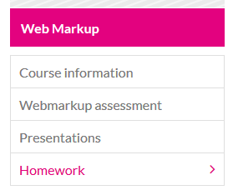
Homework for next lecture
49

